Slide 1
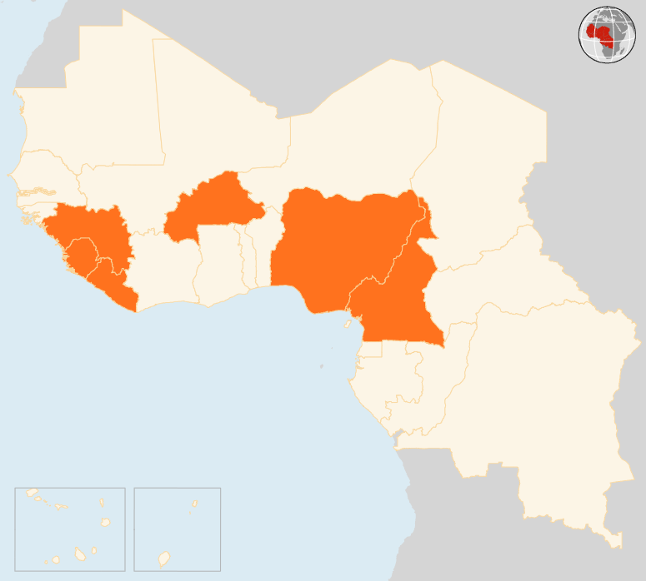

15 - 21 September 2015
BURKINA FASO
COUP D’ETAT DERAILS TRANSITION
Burkina Faso’s army converged in the capital Ouagadougou on 22 September and demanded the surrender of coup leaders who toppled the country’s transitional government. The 17 September coup has triggered protests and driven up tensions. At least 10 people have been killed and more than 100 wounded in demonstrations. Mediators from the Economic Community of West African States are seeking ways to resolve the crisis. The country had been due to hold elections on 11 October to end the transitional government.
CAMEROON
3 KILLED IN SUICIDE ATTACKS
At least three people were killed on 20 September in Mora area of the Far North Region, the latest in a series of suicide attacks that have claimed dozens of lives this month in the region that borders Nigeria’s north-east and the heartland of Boko Haram militants.
NIGERIA
45 KILLED IN MULTIPLE BLASTS
On 20 September, at least 45 people were killed and 96 injured in multiple bombings in Maiduguri, the capital of Borno State and the birthplace of Boko Haram. There was no immediate claim of responsibility for the explosions on the edge of the city centre, but the militant group has been blamed for past suicide and bomb attacks in north-eastern Nigeria.
SIERRA LEONE
9 PERISH IN FLASH FLOODS
Torrential rains and flooding on 16 September caused extensive damage to homes and property in parts of Freetown and led to the deaths of nine people. As of 18 September, 8,165 people were registered as displaced in two Freetown stadiums. Humanitarian partners are providing food rations, water and hygiene kits as well as malnutrition screening for children under the age of five.
EVD REGIONAL
1 NEW CASE REPORTED IN GUINEA
On 16 September, one new case was confirmed in Guinea. The patient was a 10 year-old girl who died at home in Kiterin area of Forécariah prefecture. Investigations to determine the source of the infection are underway in Forécariah, and Ratoma sub-prefecture where the girl hails from. No cases were reported in Liberia and Sierra Leone in the seven days prior to 20 September. In the week ending 13 September, there were five confirmed cases, all in Sierra Leone.
BURKINA FASO
COUP DERAILS TRANSITION
NIGERIA
45
KILLED IN MULTIPLE BLASTS
CAMEROON
3
KILLED IN SUICIDE ATTACKS
EVD REGIONAL
SIERRA LEONE
1
NEW CASE IN GUINEA
9
PERISH IN FLOODS
Creation date: 22 September 2015 Map data sources: UNCS, DevInfo, OCHA. Feedback: ocharowca@un.org
The boundaries and names shown and the designations used on this map do not imply official endorsement or acceptance by the United Nations.

